Slide 1

Getting Started with
ArcGIS and TypeScript
GIS Basics
TypeScript
Useful Tools & Design Patterns

Slide 2














Introduction
Partnerships/ArcGIS Specialties
Products/Services
Skyler Favors
Junior Application Developer
Notes:
- 22 yo
- Junior Developer at GEO Jobe
- I am on the professional services team, so I am constantly working on new projects for clients
- Before Geo Jobe, I was delivering pizzas on the side while I studied as much as possible.
I graduated from the MSCA, a 11 month program that teaches you how to code in a work like environment.

Slide 3


Slide 4

GIS Basics (from a software developer)
Database’s & Table’s
The Map
Layer’s
Feature’s

Slide 5


Databases & Tables
What’s a Table?
What’s a Database?
Grid of rows and columns
Also known as a spreadsheet / Excel sheet / csv file
A collection of data
A collection of tables
Organize large amounts of data in way that makes sense
Notes:
#Table:
- Is a grid of rows and columns
- Also known as a spreadsheet
- it’s a collection of data
Theirs a lot you can do with just a table of data, especially in excel.
But tables do have limits and it might not make sense to throw everything into one table.
So that’s where database’s come in.
#Database:
- Is just a collection of tables
- Allows you to organize large amounts of data in way that makes sense
Databases are very powerful; they have a lot of functionality.

Slide 6

Databases & Tables
What’s a Query?
A request for data
Examine
Manipulate
Delete
Retrieve
Notes:
The most important one being ‘queries’
- A query is just a request for data
The database is your waiter, and a query might be you asking for a cup of coffee.
The waiter then goes and looks to see if they even have coffee, and if he does, he’ll bring it to you.
But if not, he returns with nothing.
- A query is powerful because it allows to examine, manipulate, delete, or retrieve data from a complex structure.

Slide 7
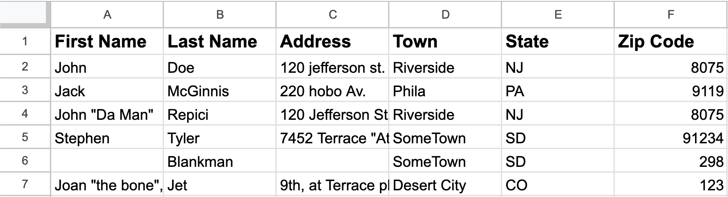
Notes:
Example Table
A query might be: grab me every row of data that has a first name that start with J
It would grab 4 rows here
Or maybe your database has 5 tables like this and you want to get everyone that lives in a certain town.

Slide 8

The Map
A map is a…
A collection of layers
Like a stack of cards
A representation of geographic or spatial data
Notes:
So now on to GIS stuff
#Map
- A map is a collection of layers
- Like a stack of cards
The order of layer’s do matter
- A representation of geographic or spatial data

Slide 9

Layer’s
A layer is…
Spatial Column
The Geometry of a location on the map
One type of geometry:
Point
Line
Polygon
A collection of data
Like a spreadsheet
Must follow some rules:
Notes:
- A collection of data
-Just a spreadsheet
But not just any spreadsheet, it must follow some rules
- It needs a spatial column because each row needs to be displayed on the map
- the spatial column can only represent one type of geometry
Point, line, polygon

Slide 10
Maps are Databases
=
Notes:
So the conclusion I’ve come to is that maps are just databases with some extra rules.
Thinking about maps and layers in this way has made learning GIS concepts easier for me. Since I was a programmer before learning all of this.

Slide 11

Feature’s
What’s a Feature?
One row in layer
Represents a location on the map
Associate data with a location
Notes:
- one row in layer
- represents a location on the map
But its not just a location, you can have data associated with the location
Its not a table but one row out of the table

Slide 12


TypeScript
What is JavaScript?
Most popular programming language
It runs the modern web
A dynamic typed language
What is TypeScript?
A super set of JavaScript
Strongly typed
Safety, result you can trust
Notes:
Enough GIS Stuff, on to developer things
Before I can talk about typescript, you need to know what javascript is.
- the most popular language to date
- it is what runs the modern web, every website uses js
- it’s what’s known as a dynamic typed language
This basically means that you don’t have to worry about types, which seems great right?
WRONG, dynamic typed langeusas are prone to lots of errors

Slide 13
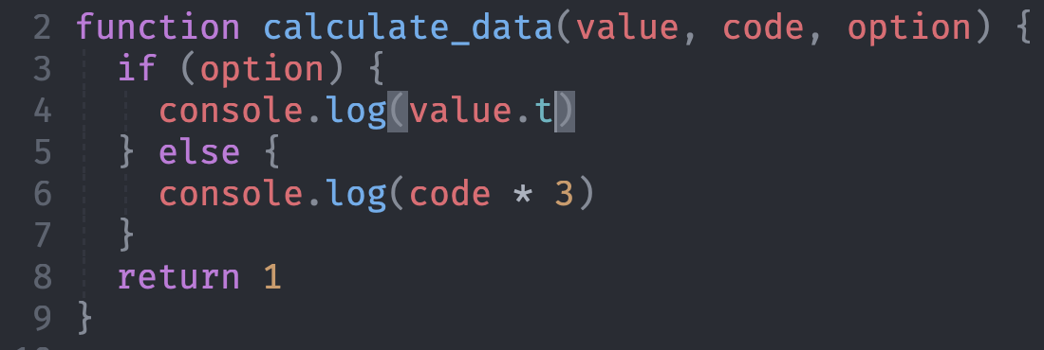
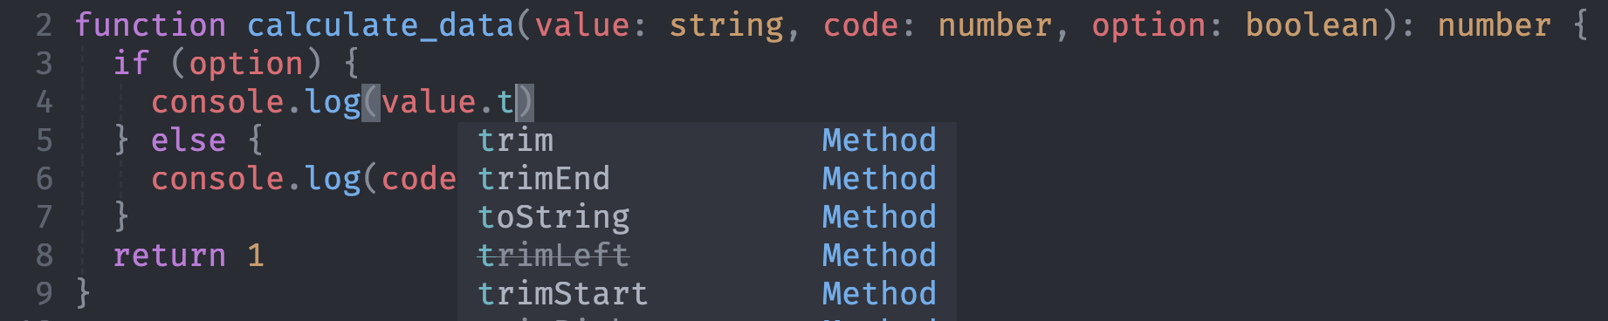

Slide 14


Useful Tools
Vite
Local Development Server
Instant Hot Reloading
Simple Build Tool
ArcGIS World Atlas
Free resources

Slide 15

The Observer Pattern
Most common design pattern in the ArcGIS Ecosystem

Slide 16
Demo
https://skylerfavors.com/
Notes:
The point of the next few slides is to show how easy it is to get up in running with arcgis and typescript

Slide 17
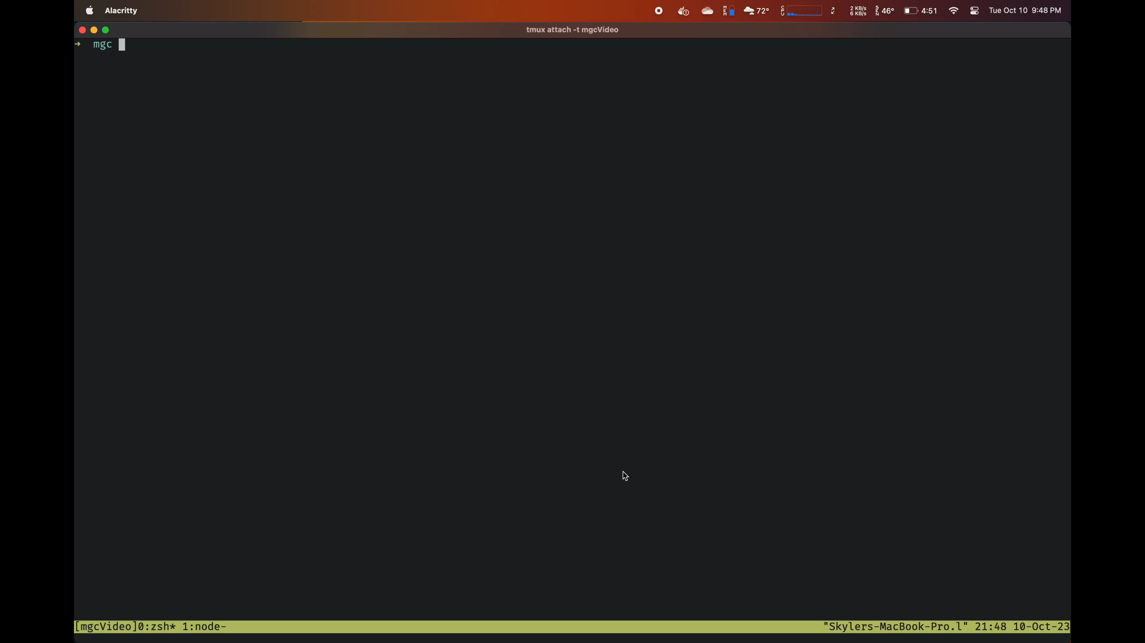
Setup & Install

Slide 18
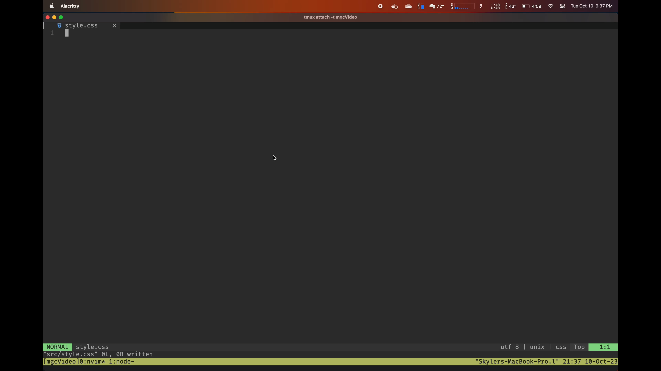
Adding the Styles

Slide 19
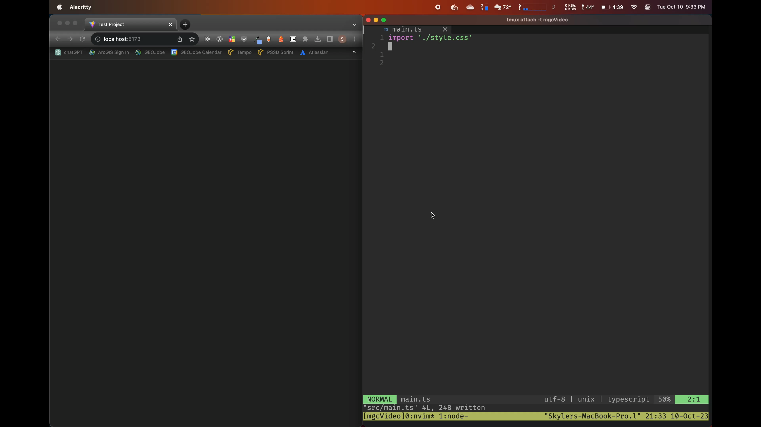
Adding the Map

Slide 20
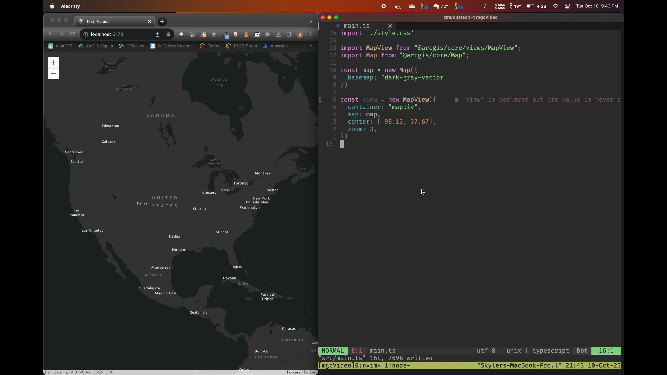
Adding a Layer

